Slide 1
Checkpoints

Slide 2
Overview
In this video, we discuss checkpoints. A few advantages of these: faster recovery and less space used for the log-file

Slide 3
Simple Checkpointing (for undo logging)
Part before checkpoint can therefore be discarded from log
Idea: checkpoint the log periodically
Every m min., after t transactions since last checkpoint, …
No need to undo transactions before the checkpoint
Procedure:
Stop accepting new transactions
Wait until all active transactions finish and have written COMMIT or ABORT record to the log.
Flush the log to disk.
Write a log record <CHECKPOINT>.
Flush the log to disk again.
Resume accepting transactions.
There are variants of checkpointing that avoid this See later!

Slide 4
Recovery via Simple Checkpoints

Slide 5
Recovery With Simple Checkpoints
These transactions have written their changes to disk (no need to undo changes)
Logfile
<CHECKPOINT>
Stop at first checkpoint
Process the undo log backwards, as before

Slide 6
Transaction 3 can then proceed after we wrote <CHECKPOINT
Time | Transaction T₁ | Transaction T₂ | Log (buffer) | Log (disk)
0
1 | read(X)
2 | X := X * 2
3 | write(X)
4
5 |  | read(X)
6 | read(Y)
7 |  | X := X * 3
8 |  | write(X)
9 | Y := X + Y
10 | write(Y)
11
12
13
14
15
16
17
18
19
<START T₁>
Transaction 3 will have to wait until we are done with our checkpoint
<T₁, X, 1>
<START T₂>
<T₂, X, 2>
Checkpointing starts
<T₁, Y, 2>
flush_log
Transaction T₃
is submitted
output(X)
output(Y)
<COMMIT T₁>
flush_log
Write <CHECKPOINT> in log and flush
flush_log
output(X)
<COMMIT T₂>
flush_log

Slide 7
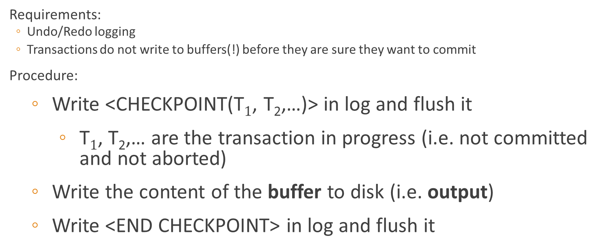
ARIES Checkpoints
Requirements:
Undo/Redo logging
Transactions do not write to buffers(!) before they are sure they want to commit
Procedure:
Write <CHECKPOINT(T$1$, T₂,…)> in log and flush it
T$1$, T₂,… are the transaction in progress (i.e. not committed and not aborted)
Write the content of the buffer to disk (i.e. output)
Write <END CHECKPOINT> in log and flush it

Slide 8
Recovery via ARIES Checkpoints
These transactions have written their changes to disk (no need to do changes)
Logfile
Stop after having found a <CHECKPOINT(T₁,T₂,…)>
with corresponding
<END CHECKPOINT>
AND <START T_{i}> for all mentioned transactions that are uncommitted
<START T₁>
<CHECKPOINT(T₁,T₂,…)>
Process the undo/redo log, as before EXCEPT:
only redo part of committed transactions in T₁,T₂,… after <CHECKPOINT(T₁,T₂,…)>
AND then undo all of uncommited transactions in T₁,T₂,…
incl. before <CHECKPOINT(T₁,T₂,…)>
<END CHECKPOINT >

Slide 9
Summary
Checkpoints can be used to speed up recovery and use less space on the log files
We saw Simple Checkpoints which simply prevents new transactions from starting until all are done
We saw ARIES Checkpoints that were more advanced and required undo/redo and you can’t write to the buffer before being sure you want to commit

